Slide 1
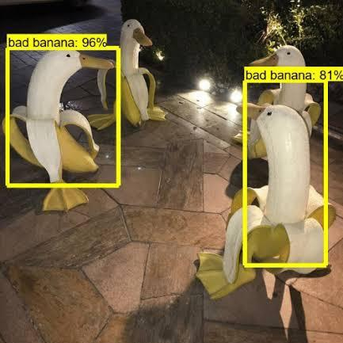
Compute the Optical Flow to Determine the Direction of the Vehicles
Team 3 : BEST COMPUTER VISIONARISTS
Jaume Pladevall, Batuhan Sakal, Luis Carranza and Anna Escolano
Notes:
Batu

Slide 2
Table of contents
Goals
Agile methodology
Kanban
Documentation tool
Optical flow
Detect the cars moving
Find vectors at the moving locations
Detect the changing lane
Detect the direction in which the car is moving
Results and outcomes
Notes:
Anna

Slide 3
1. Goals of this project
Learn&Use Agile Methodology
Learn how to use Collaboratory
Compute the Optical Flow to determine the direction of the vehicles
Notes:
Anna

Slide 4
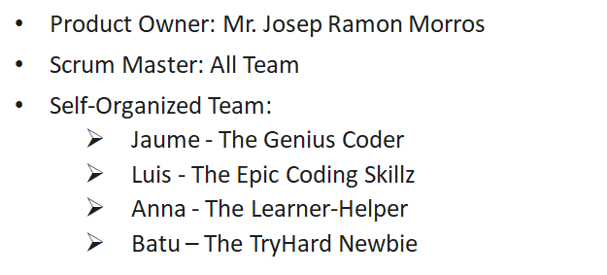
2. Agile Project Management
Scrum Framework
User Story
•Sprint: 1 Week Work Cycle
•User Story: Given by the Professor
•Daily Scrum: Everyday 3 PM.
-Detecting the cars in the static camera videos
-Determine the car directions using the optical flow vector
-Detecting while the car is changing lane from the in-car perspective
Roles
Ceremonies
•Opening: Monday - What and how to do?
•Daily scrum: Everyday - What did and will do?
•Closure: Friday - Let’s start the Show!
Good
Could Be Better
✓Communication
✓Team-Support
✓Technical Skills
±More Focusing Time
±A better CV Background
±More Jaume :D
Notes:
Batu

Slide 5
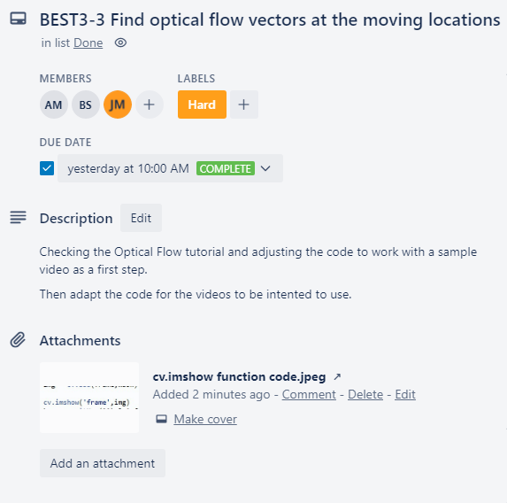
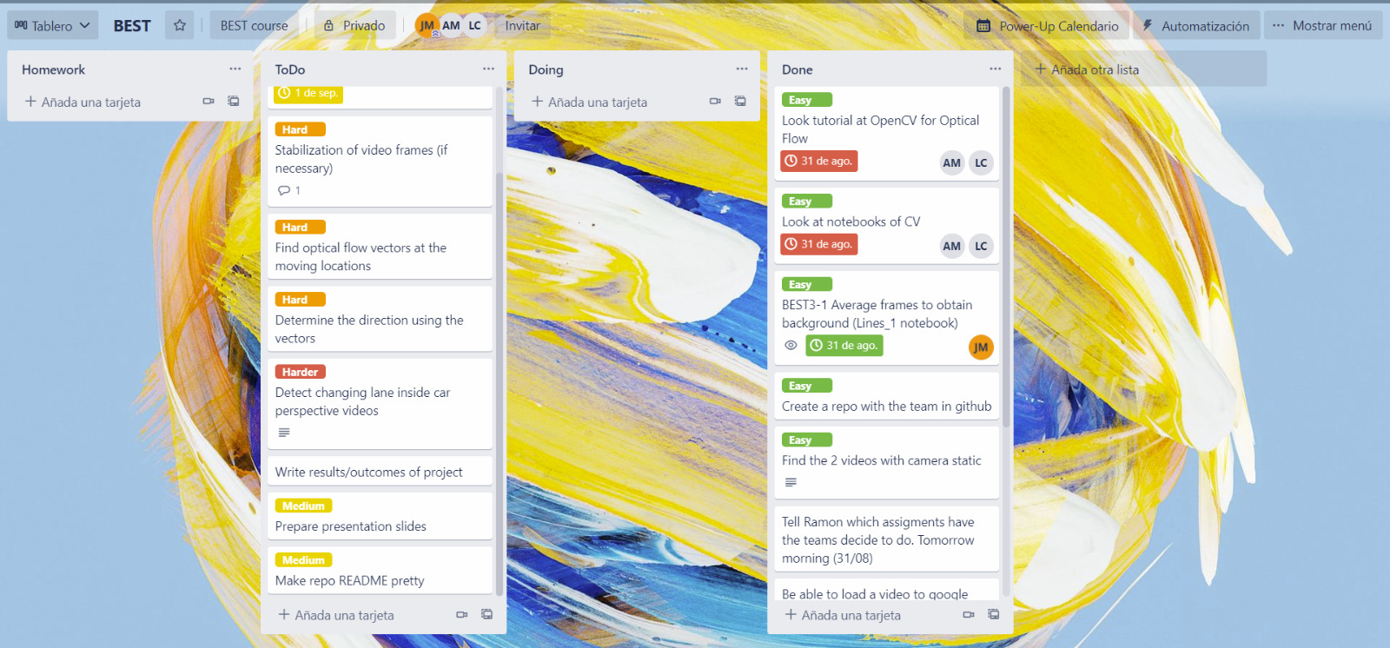
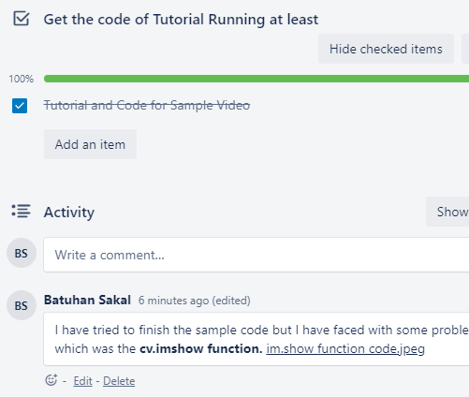
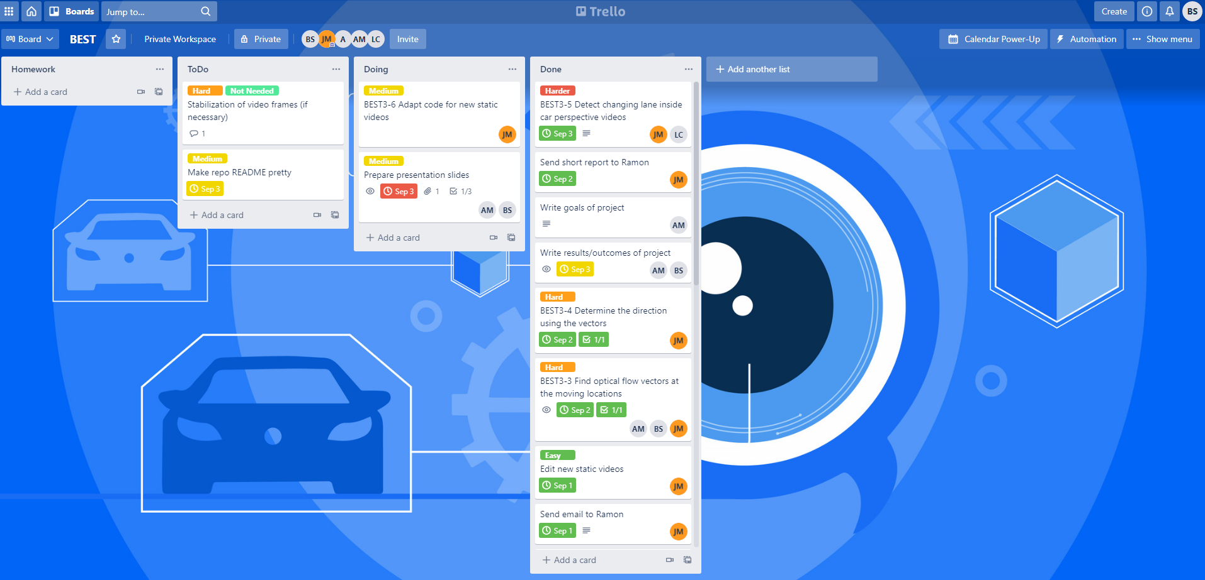
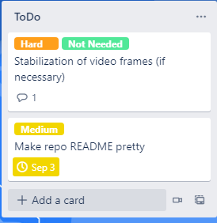

Kanban: Trello Board
-Customize Board
-Create Tasks
-Build Workflow
-Label & Assign Tasks
First Day
Lean Principles
Deliver as
early as
possible
Prepare the codes with sample videos until the real videos to use
Last Day
Amplify
learning
First check the the tutorials & notebooks then work with code
Empower the team
Whatsapp Group to communicate instantaneously and conveniently
Best Comment!
Notes:
Batu

Slide 6
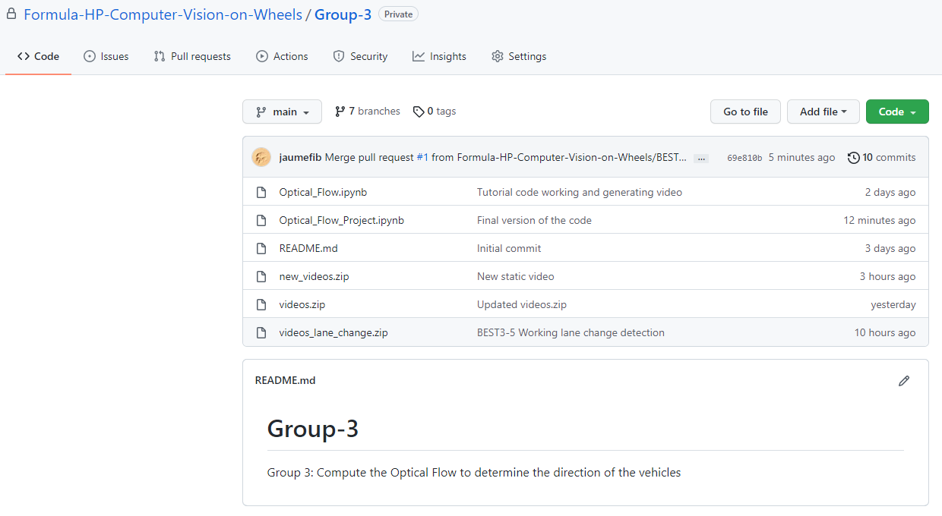
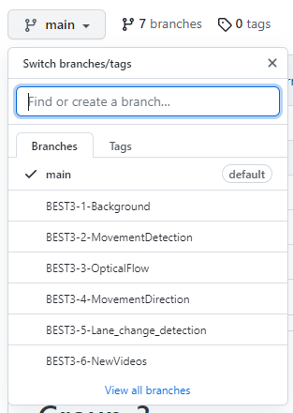
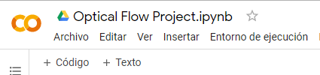
b. Documentation Tool: Github
1 Shared Code that everybody can reach Any Moment
Save&Update the code As Soon as possible for team to reach
Creating Back-Up Codes in GitHub Just in Case
Upload Videos, Codes and Other Documents to GitHub to reach them fast
In GitHub / Be organized as much as possible with branches
Notes:
Batu

Slide 7
3. Compute the optical flow
Tasks:
Detect the cars moving in static camera videos by subtracting frames
Find the optical flow vectors at the moving locations
Detect the changing lane inside the car perspective videos
Detect the direction in which the car is going by using vectors
From static camera videos
From inside-car camera videos
Notes:
Anna

Slide 8

Detection of moving objects
Subtasks:
Average pixel in frames to retrieve the background
ROI mask to scope our detecting area
Erosion and Dilation to reduce noise
Subtract the frames with the background to detect the cars
Notes:
Jaume

Slide 9
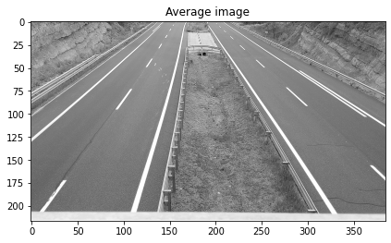
Detection of moving objects
Average pixel in frames to retrieve the background
Subtasks:
Average pixel in frames to retrieve the background
ROI mask to scope our detecting area
Erosion and Dilation to reduce noise
Subtract the frames with the background to detect the cars
Notes:
Jaume

Slide 10
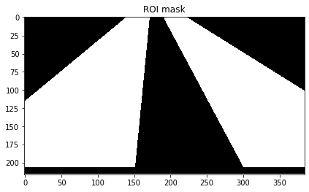
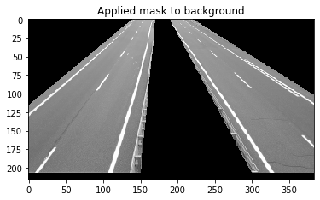
Detection of moving objects
ROI mask to scope our detecting area
Subtasks:
Average pixel in frames to retrieve the background
ROI mask to scope our detecting area
Erosion and Dilation to reduce noise
Subtract the frames with the background to detect the cars
Notes:
Jaume

Slide 11
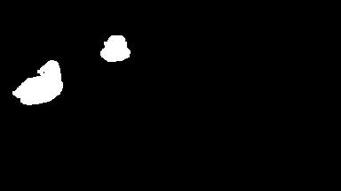
Detection of moving objects
Erosion and Dilation
Subtract the background from the frames
Subtasks:
Average pixel in frames to retrieve the background
ROI mask to scope our detecting area
Erosion and Dilation to reduce noise
Subtract the frames with the background to detect the cars
Notes:
Jaume

Slide 12
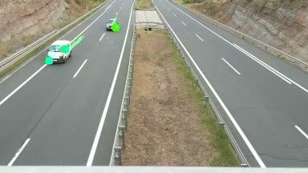
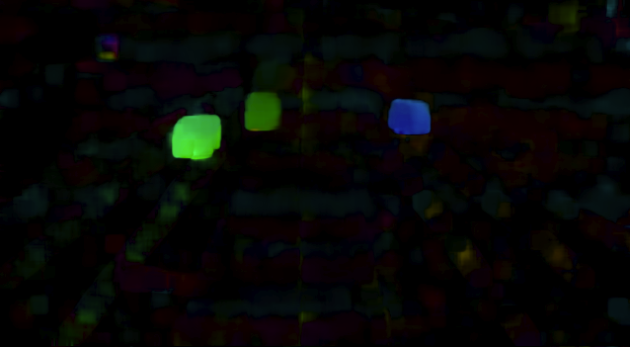
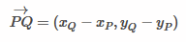
b. Find the optical flow vectors at the moving locations
Subtasks:
Shi-Tomasi to get points of interest
Lucas-Kanade to track the motion of these points
Direction of movement
Dense Optical Flow (a)
Vectors (b)
(a)
(b)
Notes:
Jaume

Slide 13
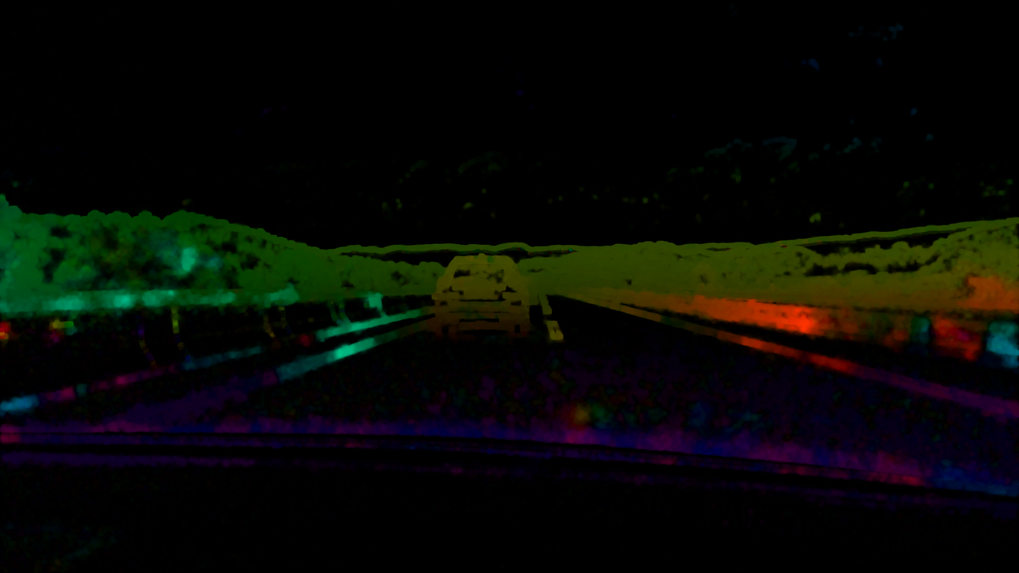
c. Detect the changing lane inside the car perspective videos
Subtasks:
ROI mask to scope the background
Farneback to detect the motion among all pixels
Plot the X-component motion vector to check its usefulness
ROI mask to scope the background
Farneback to detect the motion among all pixels
Notes:
Luis

Slide 14
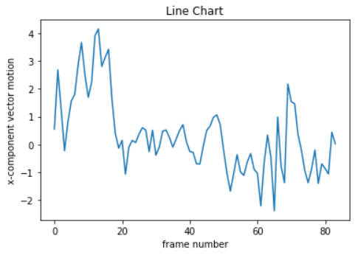
d. Detect the changing lane inside the car perspective videos
Subtasks:
ROI mask to scope the background
Farneback to detect the motion among all pixels
Plot the X-component motion vector to check its usefulness
Plot the X-component motion vector to check its usefulness
Notes:
Luis

Slide 15
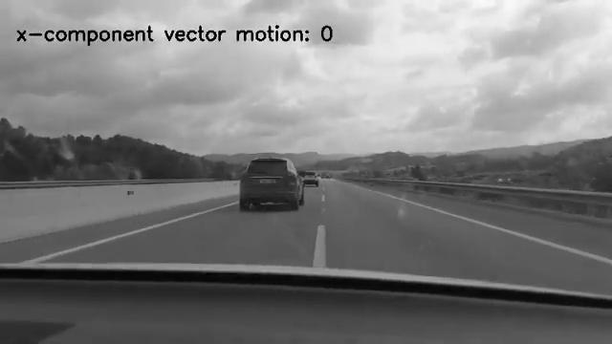
d. Detect the changing lane inside the car perspective videos
Subtasks:
From static camera videos
Y-component motion vector from points of interest
From inside-car camera videos
Average X-component motion vector
Notes:
Luis

Slide 16

4. Results of the Project
Learnt&Used agile methodology and collaboratory ✅
Learnt Computer Vision and Optical Flow ✅
Created a detector to determine the direction of the vehicles
from in and out perspectives of the cars✅
Learnt to work with people with different cultural backgrounds✅
Had great friends in similar area of work!
Notes:
Anna

Slide 17
Improvements
Unwanted artifacts in the optical flow
For the Changing Lane task
need to do validation and testing in different environments to check

Slide 18
Thank you for listening

